Slide 1
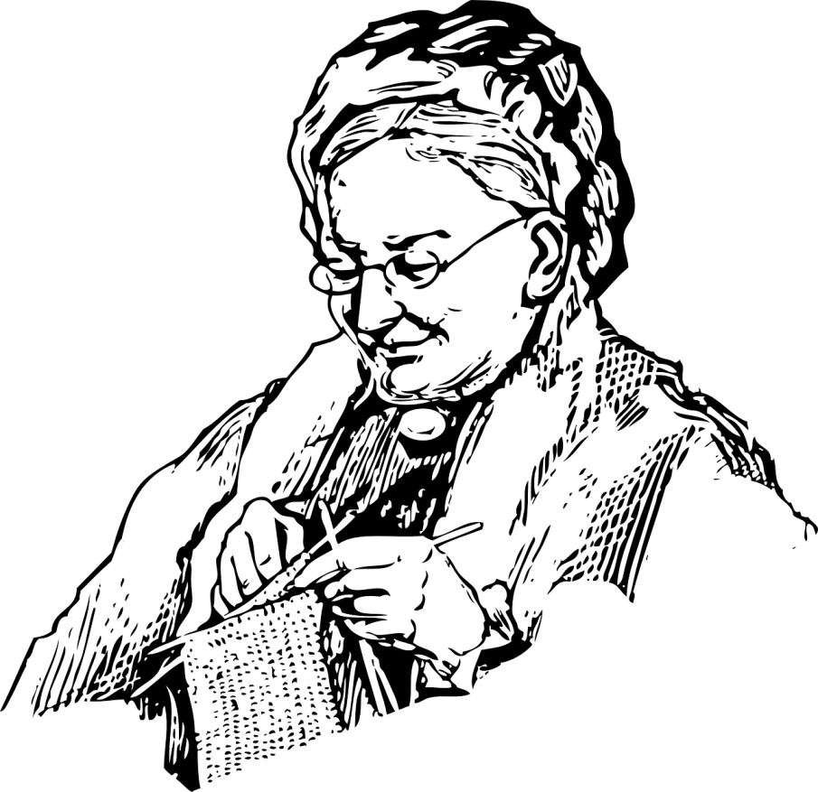
We need to talk
about granny

Slide 2
Ageism - stereotyping, prejudice, and discrimination against people on the basis of their age.
World Health Organisation (2018)

Slide 3
Ageism is the most socially “normalised” kind of prejudice.
World Health Organisation (2018)

Slide 4
What about ELT?

Slide 5
Images of people | Images of older adults | % of older adults
169 | 6 | 3.55%
155 | 11 | 7.10%
224 | 10 | 4.46%
364 | 10 | 2.75%
194 | 5 | 2.58%
Percentage of images portraying older adults in five ELT coursebooks made in Brazil. 2019

Slide 6
The percentage of photos of older people needs to correspond approximately to the percentage of older people in the population.
Couper and Pratt (1999)

Slide 7
Where are they?

Slide 8
Family tree
Adjectives
Past actions or habits
Superlatives

Slide 9
Who are they?

Slide 10
Helpless person
Lonely and/or grumpy person
Couple walking the dog
Sweet grandparents

Slide 11
What do most of them
have in common?

Slide 12
-No occupation;
-No friends;
-No hobbies or interests;
-No name;
-No voice.

Slide 13
What can we do?

Slide 14
1
Represent older adults as ‘normal’ people, living their lives.

Slide 15
2
Be mindful when requesting illustrations depicting older people.

Slide 16
3
Prefer to represent older adults as active people who work, socialise with friends, and use technology.

Slide 17
4
Include older adults as much as possible, and in varied roles.

Slide 18
5
Give them a name, a voice, a life.

Slide 19
How can we do it?

Slide 20
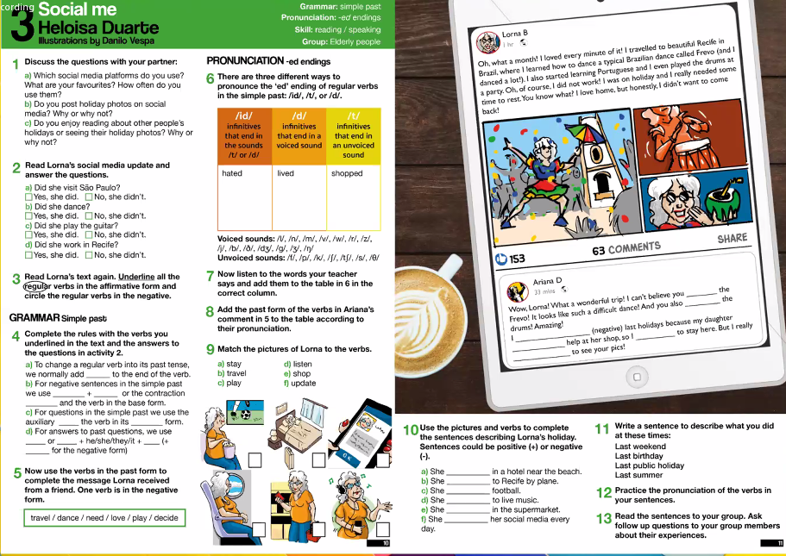

Slide 21

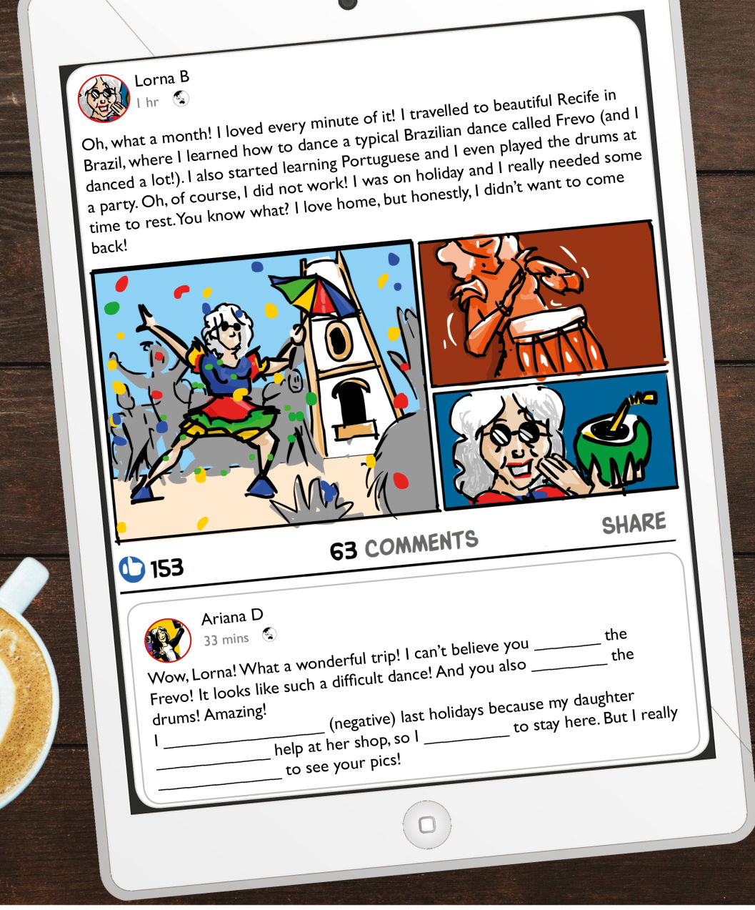
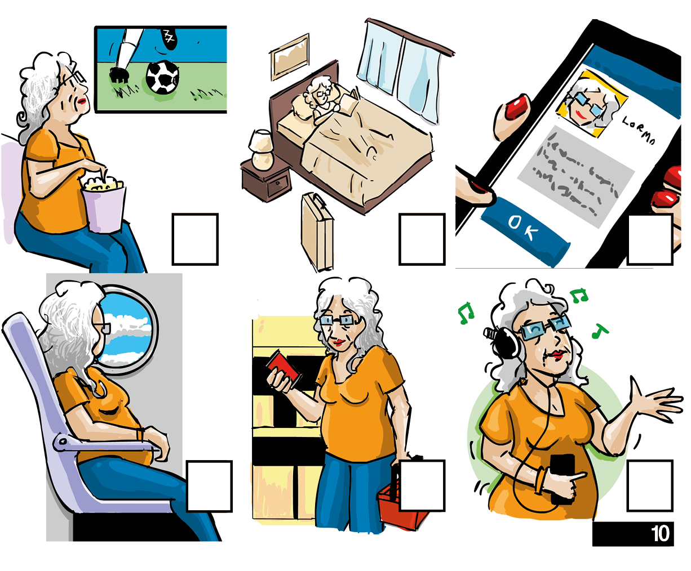

Slide 22
When in doubt, send me a line!
helohcd00@gmail.com

Slide 23
REFERENCES
World Health Organization (2018) A global campaign to combat ageism. [Online] Available from: https://www.who.int/bulletin/volumes/96/4/17-202424/en/ [Accessed 11th December 2019].
Jönson, H. (2012) We will be different! Ageism and the temporal construction of old age. The Gerontologist, 53, 198–204.
Couper, D. P. and Pratt, F. (1999) Learning for longer life: a guide to aging education for developers of K-12 curriculum & instructional materials. Denton, National Academy for Teaching and Learning about Aging.

